Slide 1
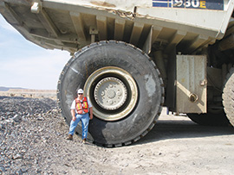
Tire Maintenance & Inspection

Slide 2
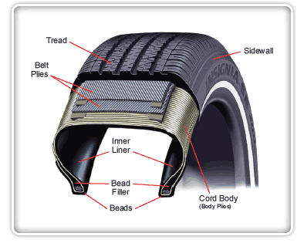
Common Terms

Slide 3
The Manufacturer’s Vehicle Weight Rating Chart

Slide 4
The Manufacturer’s Vehicle Weight Rating Chart

Slide 5
The Manufacturer’s Vehicle Weight Rating Chart
Axel Weight Ratings

Slide 6
The Manufacturer’s Vehicle Weight Rating Chart
Tire Specs.

Slide 7
Proper Tire Inflation
Cold Tire Inflation

Slide 8
Inspecting The Tread

Slide 9
Tread Depth Not Less Than 4/32 On Fire Apparatus

Slide 10
Typical Wear Pattern on Tak 4 Suspension. Shoulder Tread Wears much Faster Than Center Tread

Slide 11
Tread Layer worn Completely Through

Slide 12
Visible Condition Known As “Blotching”

Slide 13
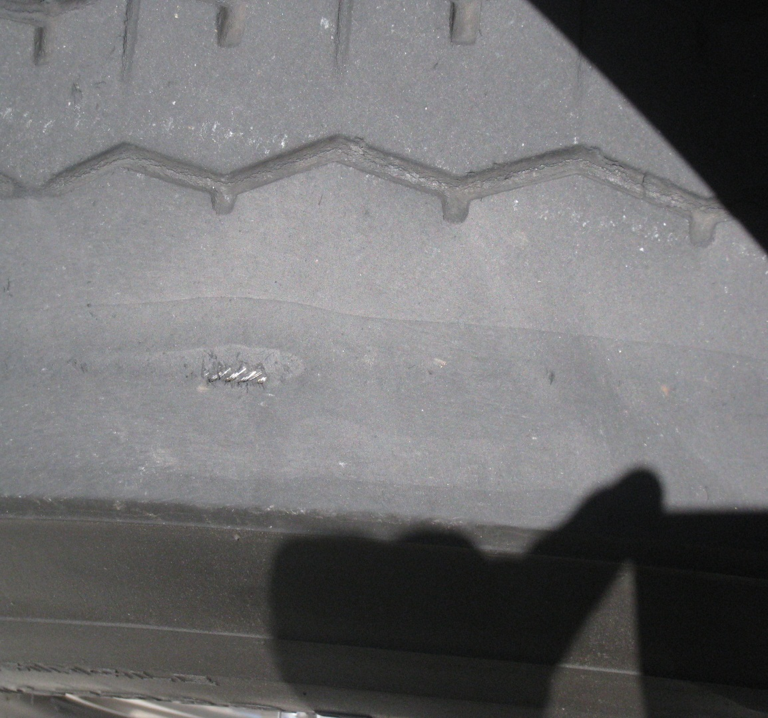
Cord Or Belt Showing

Slide 14
The Responsibility Is On YOU!!!
Check Tread Depth Daily
Maintain Proper Tire Pressure
Have Tires Rotated In Order To Maximize Lifespan
Have Tires Replaced When ANY Area Of The Tread Wears Below 4/32

Slide 15
The Responsibility Is On YOU!!!
OUT OF SERVICE CRITERIA
Tread Depth Below 4/32
Improper Inflation
Damage To Tread, Sidewall Or Bead
Bubbles Or Blisters
Any Impaled Objects
*If You Are Not Sure… Have The Tire Inspected By A Dept. Mechanic Or Wingfoot.

Slide 16
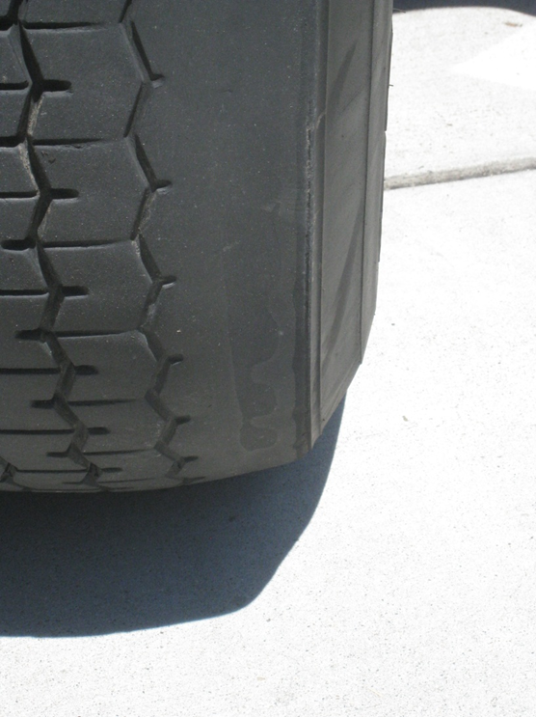
Don’t Forget, Either Of These Conditions Can: Get You Multiple Tickets

Slide 17
Don’t Forget, Either Of These Conditions Can: Or Prove Negligence In An Accident

Slide 18
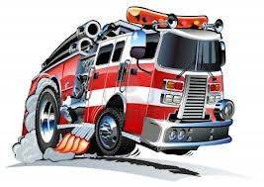
Ya’ll Have A Safe Trip…
And Keep The Rubber Side Down!

Slide 19
Record your training hours!

